Slide 1
Secure Data Hiding in image using steganography.
CAPSTONE PROJECT
Presented By: R.D.R SaiGanesh
Student Name : R.D.R SaiGanesh
College Name & Department : Miracle educational Society Group of Institutions

Slide 2
OUTLINE
Problem Statement
Technology used
Wow factor
End users
Result
Conclusion
Git-hub Link
Future scope

Slide 3
Problem Statement
The basic problem statement in steganography, where the task is to hide a message in another piece of information (e.g., an image, audio file, etc.) without leaving any visible signs that the message is there

Slide 4
Technology used
1.Python Idle.
2.cv2 pip library
3.Github
4. OS :- Window
5.System :- Dell laptop [ processor :- 11th Gen Intel(R) Core(TM) i5-1135G7 @ 2.40GHz 2.42 GHz, 8Gb Ram]
6.Steganography encryption and decryption with keys.

Slide 5
Wow factors
1.Hiding Data with Simple Steganography Website.
2.Having private and public Keys.
3.Learned basics of cybersecurity.

Slide 6
End users
individuals or organizations requiring secure, covert communication, such as journalists, whistleblowers, military personnel, law enforcement agencies conducting undercover operations, or even businesses looking to protect sensitive data by hiding it within seemingly ordinary files

Slide 7
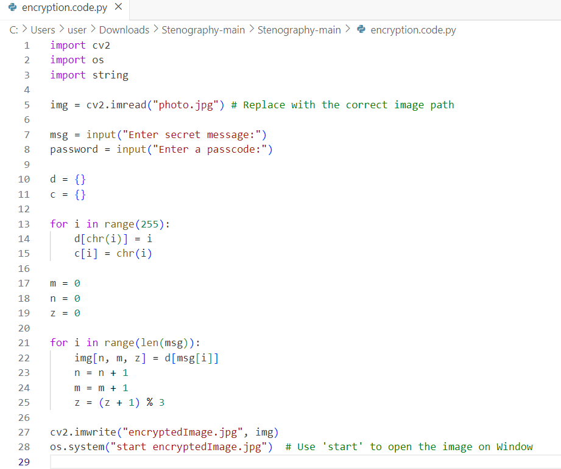

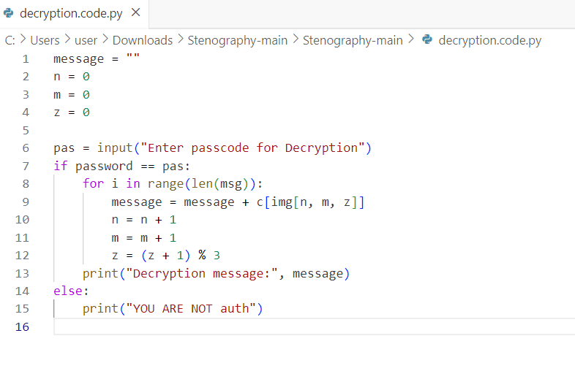
Results

Slide 8
Conclusion
In conclusion, image steganography is a powerful and evolving technique that plays a crucial role in secure communication and data protection. By embedding secret information within the pixels of an image, steganography provides a covert channel for transmitting sensitive data without arousing suspicion.

Slide 9
GitHub Link
https://github.com/Rednam087/MyProjectedunet-2025.git

Slide 10
Future scope(optional)
In the near future, the most important use of steganographic techniques will probably be lying in the field of digital watermarking

Slide 11
THANK YOU

